Slide 1

INSTITUTE FOR EXCELLENCE IN HIGHER EDUCATION
Name:-Krishna Raghuwanshi
Class:- B.SC 2nd year (mathematics)
Roll number:-324439
Subject:-computer science
Topic:-Robotics

Slide 2
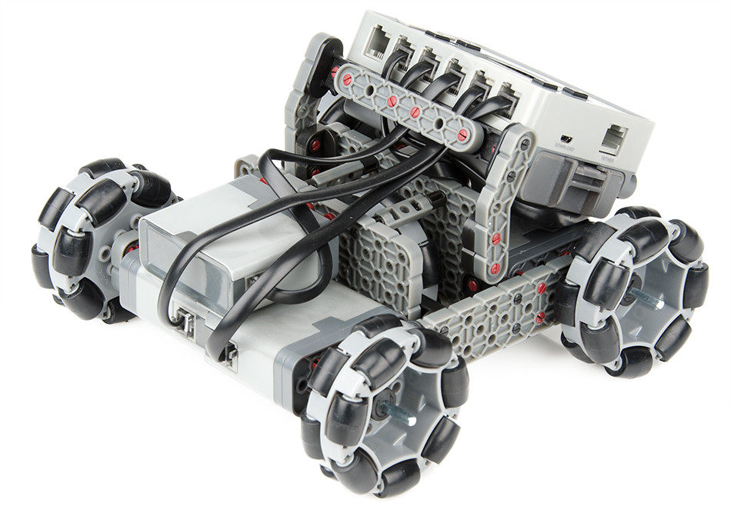
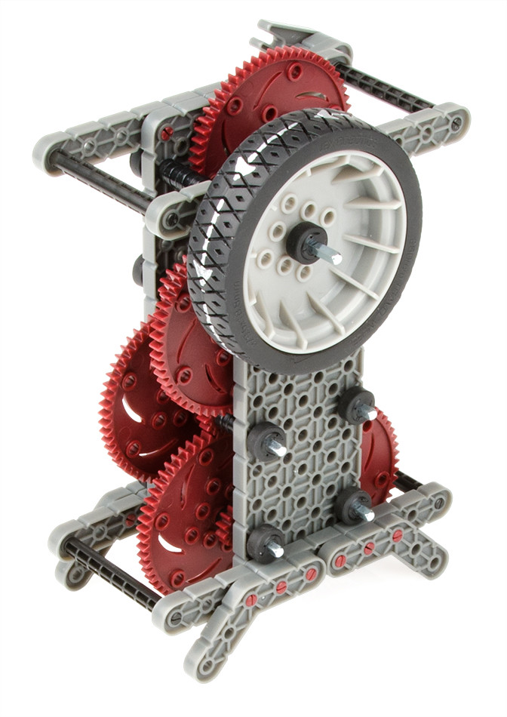
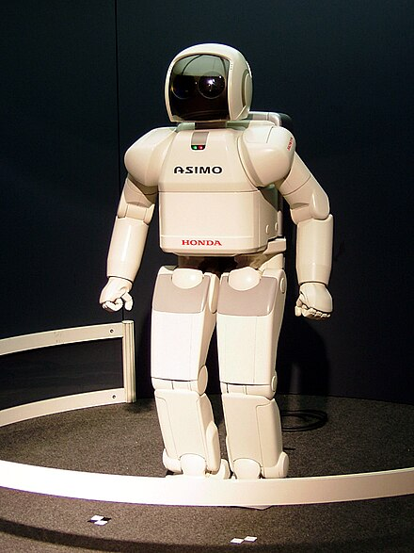
ROBOTICS

Slide 3
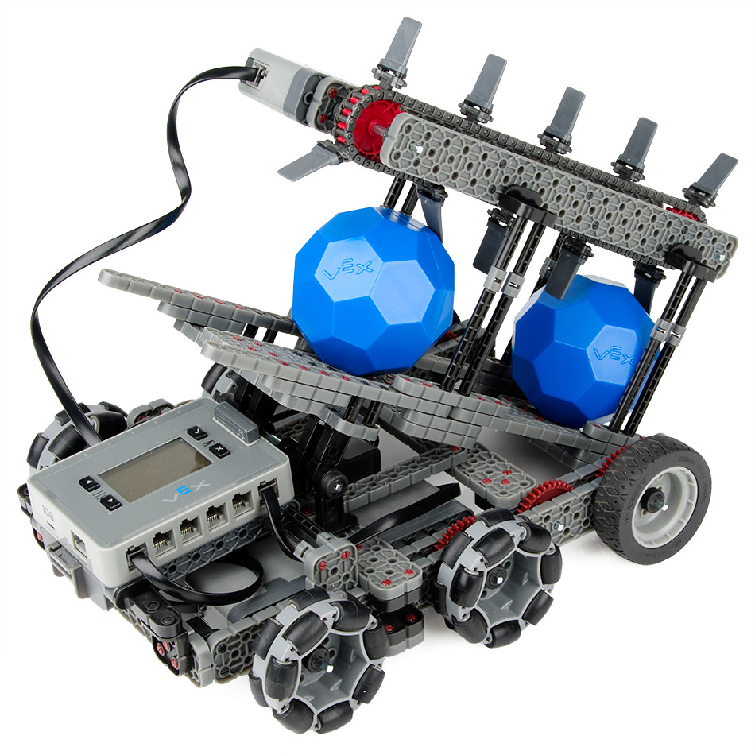
ROBOTICS
Robotics is a branch of engineering and computer science that involves the conception , design, manufacture and operation of robots . The objective of the robotics field is to create intelligent machines that can assist humans in a variety of ways .

Slide 4
WHAT IS ROBOTICS
A robots is a machine ,often controlled
by a computer, that can perform tasks
automatically. Robots can very widely in
form and function, from industrial
robotic arms to autonomous vehicle
and even domestic devices.
Notes:
A robot is a often controlled by a computer, that can perform tasks automatically. Robots can very widely in form and function, form industrial robotic arms to autonomous vehicles and even domestic devices.

Slide 5

WHY IS ROBOTICS NEEDED…?
Robotics is needed because :-
Speed
Can work in hazardous/dangerous temperature
Can do repetitive tasks
Can do work with accuracy

Slide 6
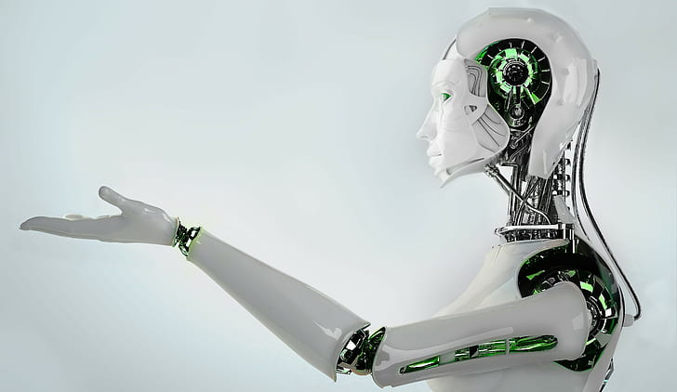
ROBOTIC TECHNOLOGY
Processors
Sensors
Controllers
Actuators
Effectors
Arms

Slide 7
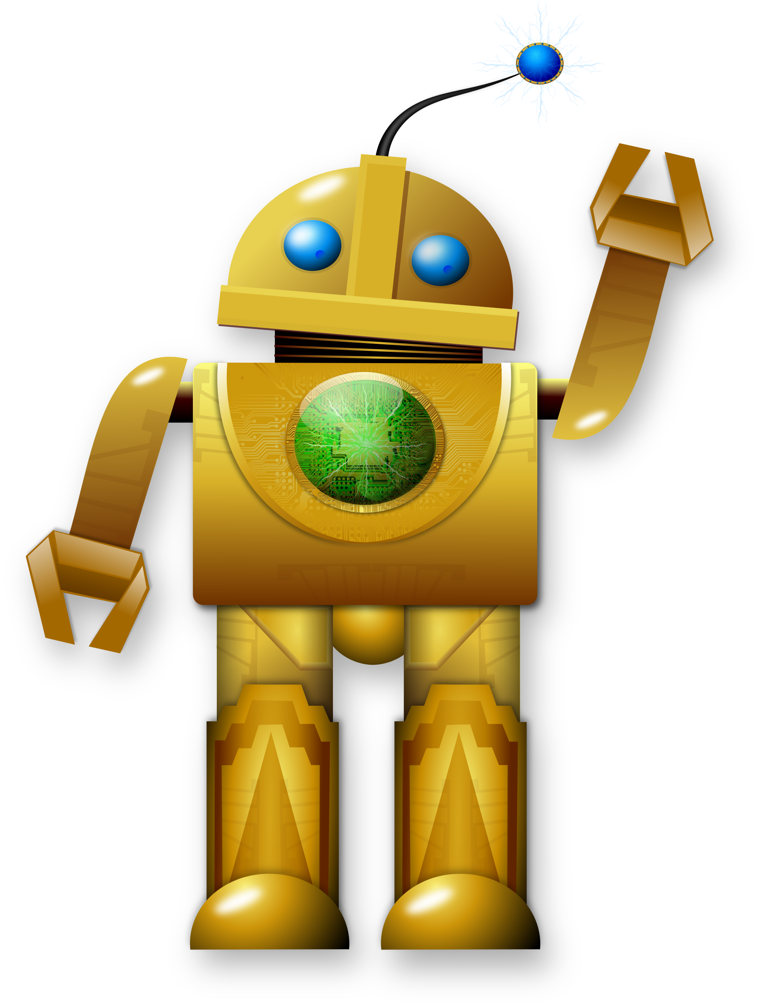
Types of Robot
Mobile Robots.
Stationary Robots.
Remote Controlled Robots.
Autonomous Robot
Virtual Robots
Ai Robots
Mobile Robots.
Stationary Robots.
Remote Controlled Robots.
Autonomous Robot
Virtual Robots
Ai Robots

Slide 8
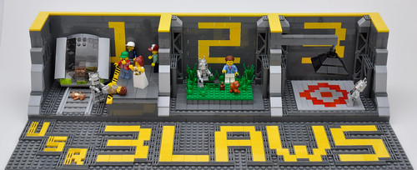
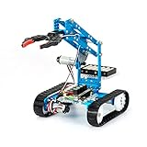
ROBOTIC HISTORY
First use of the word “Robotics
Three Laws of Robotics
The first robot “Unimate

Slide 9
First use of the world Robotic
The world robot was introduced to the public by Czech writer karel
(1890-1983) in his play R.U.R published in 1920 . The play begins in a
Factory that makes artificial people called robotics .
The world used to describe this field of study. American scientist &
Science fiction writer made the robot form .
Studying robotics

Slide 10
3 Laws of Robotics
A robot may not injure humanity .
A robot must obey orders given it by human beings.
A robot must protect its own existence .

Slide 11
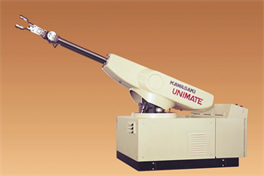
The first robot Unimate
The first industrial robot the Unimate was install-
ed by General Motors in (1961).
This robot featured a motorized arm with over
two- ton weight . It carried by step command-s
s that were stored on the magnetic drum.

Slide 12

THANK
YOU

